Slide 1
Immigrant Veterans and the Memory of the Mexican War

Slide 2
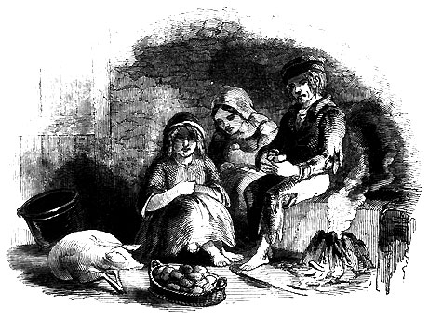
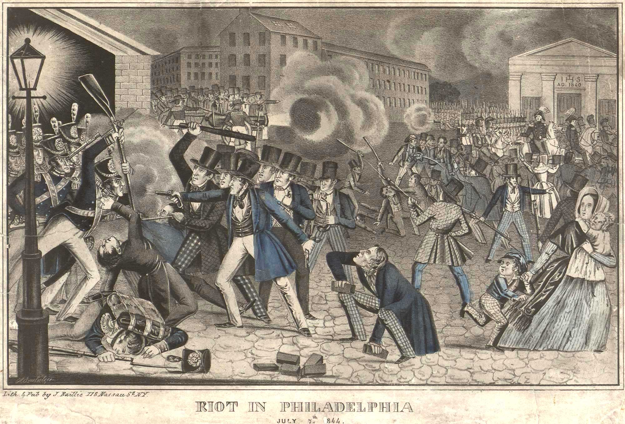
Antebellum Immigration
A. New Opportunities
B. Nativism

Slide 3
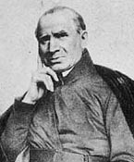
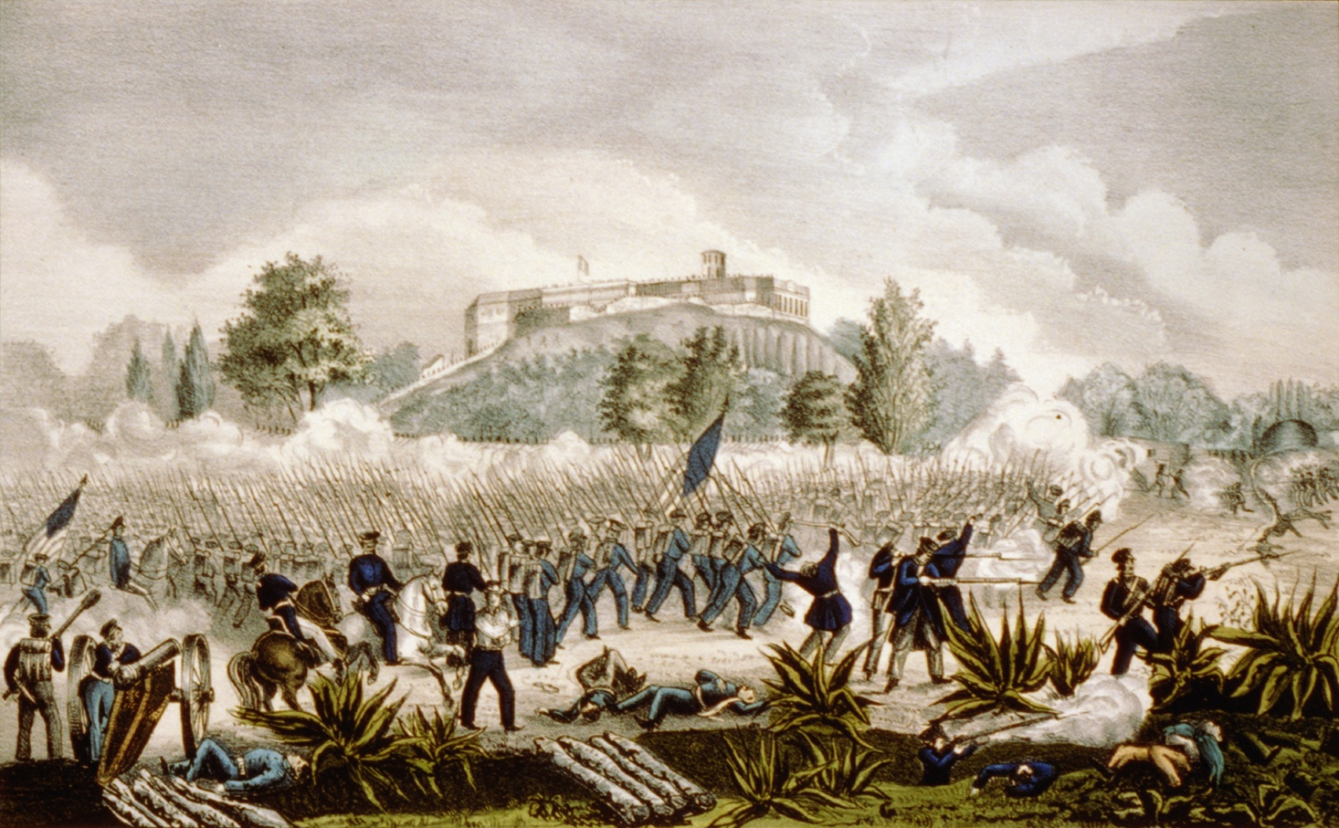
The U.S.-Mexican War
A. The War & Catholicism
B. Volunteers in Combat

Slide 4
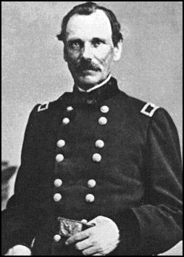
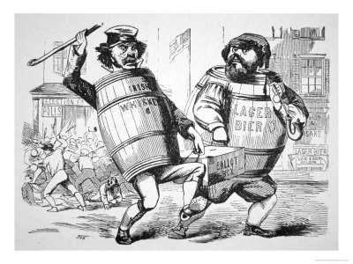
Memory of the War
A. Heroes
B. Reaction

Slide 5
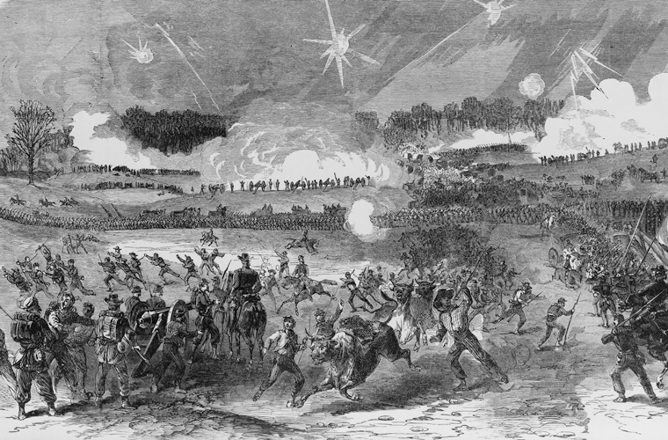
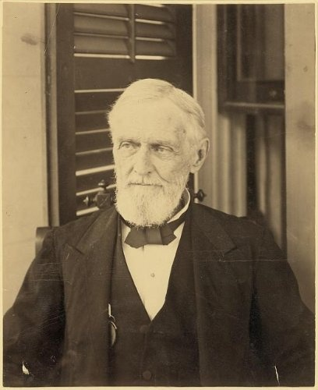
C. Civil War Dominates Memory
D. Fighting over Pensions

