Slide 1
Assessing Habits of Mind from Eighth to Twelfth Grade
Miles McCrimmon and Rob Meister
Tenth Annual Faculty Research Symposium
Reynolds Community College
April 1, 2016

Slide 2
Guiding Purpose of Study
How do students’ attitudes about specific habits of mind change over the course of their four years in the ACA program?
What causes these changes?

Slide 3
Predecessors
Janet Emig, The Composing Processes of Twelfth Graders (1971)
  Key finding in this case study of eight Chicago-area twelfth graders: students engage in two modes of writing – “reflective” (self-sponsored) and “extensive” (school-sponsored) – and these two modes are often in conflict.
Nancy Sommers, “The Call of Research: A Longitudinal View of Writing Development” (2008)
  Based on the longitudinal study of Harvard first-year writing students undertaken in 2001 and continued across the four years of their undergraduate education
  Asking the central question: “Do seniors graduate as stronger i.e. better writers than when they entered as freshmen?” (153)

Slide 4
Context of Study
Reynolds Advance College Academy at J.R. Tucker HS
39 HS Seniors who are soon to be graduates of the Reynolds ACA
Two writing samples:
  ACA Application Essays submitted in eighth-grade in March, 2012 (extensive – written to gain entrance into the program)
  Follow-Up Essays elicited by English instructors in twelfth-grade in December, 2015 (reflective – written as part of an assessment/research study)

Slide 5
Prompt 1: Eighth-Grade Application Essay
Success in college-level work requires certain habits of mind:
curiosity, creativity, flexibility, openness, persistence, responsibility, engagement in your own learning, and the ability to reflect on your own thinking. In an essay, describe how you have already developed three of these habits, and identify at least one habit you will need to develop further in order to make the most of this opportunity to accelerate your move into higher education. Please limit your essay to 500 words.

Slide 6
Prompt 2: Twelfth Grade Self-Assessments
Review your eighth-grade response to the prompt carefully in order to write a new essay as a member of the ACA Class of 2016. Based on your experience in the ACA, both in and out of the classroom,
How would you answer this same prompt differently today?
Which of these habits have you developed most? How? Where? When? With whom?
Which of these habits do you still need to develop in order to navigate your next transition into higher education at the four-year college/university next year?

Slide 7
8th Grade: Perceived Strengths
Ranking | Habit of Mind | Responses
1 | curiosity | 23%
2 | responsibility | 17%
3 | persistence | 16%
4 | openness | 12%
5 | creativity | 11%
6 | flexibility | 9%
7 | engagement in own learning | 7%
8 | reflection on thinking | 5%

Slide 8
12th Grade: Perceived Strengths
Ranking | Habit of Mind | Responses
1 | responsibility | 21%
2 | curiosity | 18%
3 | persistence | 17%
4 | flexibility | 15%
5 | openness | 12%
6 | creativity | 7%
7 | engagement in own learning | 6%
7 | reflection on thinking | 6%

Slide 9
8th vs. 12th Grade Habits of Mind Perceived Strength Comparison

Slide 10
Key Findings: Strength Comparison
From 8th Grade and 12th Grade, the top three perceived strengths are still curiosity, responsibility, and persistence.
From 8th Grade to 12th Grade, curiosity and creativity decline most significantly as strengths.
Neither engagement nor reflection is perceived to be a major strength in 8th or 12th grade.

Slide 11
8th Grade: Habit to Develop
Ranking | Habit of Mind | Responses
1 | creativity | 21%
1 | reflection on thinking | 21%
2 | openness | 18%
3 | flexibility | 15%
4 | persistence | 12%
5 | responsibility | 6%
5 | engagement in own learning | 6%
6 | curiosity | 3%

Slide 12
12th Grade: Habit to Develop
Ranking | Habit of Mind | Responses
1 | creativity | 22%
2 | flexibility | 19%
2 | engagement in own learning | 19%
3 | openness | 14%
4 | persistence | 11%
5 | reflection on thinking | 8%
6 | responsibility | 6%
7 | curiosity | 0%

Slide 13
8th vs. 12th Grade Habit of Mind to Develop Comparison

Slide 14
Key Findings: Development Comparison
From 8th to 12th grade, creativity, flexibility, and engagement increase as habits that most need to be developed.
From 8th to 12th grade, engagement rises most significantly as the habit that most needs to be developed.
From 8th to 12th grade, reflection declines most significantly as the habit that most needs to be developed.
By 12th grade, no student perceives curiosity as the habit that most needs to be developed.

Slide 15
Other Key Questions
From 8th to 12th Grade, flexibility is the only habit that increases both as a strength and as a habit that needs to be developed. Why?
10 out of 32 respondents identified the same habit to develop in 8th grade as well as 12th grade (4 identified creativity, 3 openness). Why?
Why did reflection plummet and engagement spike as habits that most need to be developed?

Slide 16
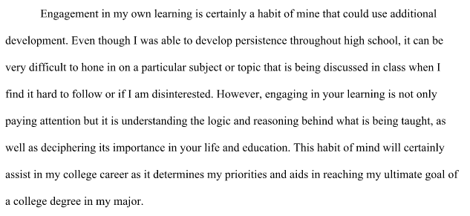
Student Excerpt: Defining Engagement

Slide 17
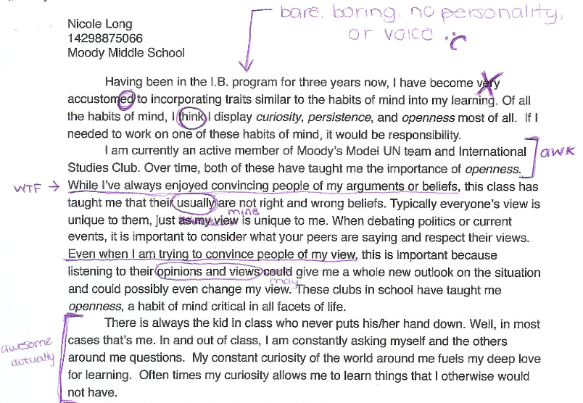
Self Reflection: 12th grade annotation of 8th grade paper

Slide 18
Next Steps for Class of 2017
Add a mandatory step asking students to “annotate” their eighth-grade essays.
Rewrite the 8th grade prompt in a clear way so that it is geared to the pre-high schooler mindset.
To ensure that all respondents support accurate data collection, require that students pick their top 3 perceived strengths and rank them in order.
Continue to trace trends and inclinations surrounding habits of mind between 8th and 12th grade.
Rephrase Question 2 of Twelfth Grade Prompt (“Which of these habits have you developed most? How? Where? When? With whom?) into more of an invitation to present a kind of Phase Two portfolio response with actual evidence.
Use assessment results to refine ACA curriculum and experience in order to embed moments of orchestrated serendipity.

